Slide 1
Decision Trees & Random Forest Classifiers
Week 3

Slide 2
Process of Machine Learning - Review
Compile/find dataset → example Iris cancer dataset, and show intuitive representation (define: instances, features, output value, predicted value)
Split dataset into train and test
Create algorithm framework
Feed data from dataset to algorithm using training data (training phase)
Evaluate performance of algorithm using test data (testing phase)

Slide 3
Decision Trees (I)
Family of ‘CART’ algorithms
Builds classification models in the form of a tree structure
Breaks down a dataset into smaller and smaller subsets, while at the same time an associated decision tree is incrementally developed

Slide 4
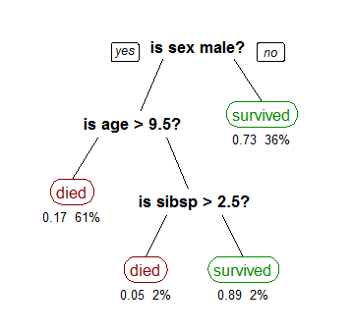
Decision Trees (II)

Slide 5
Decision Trees (III)
Find feature with highest ‘information gain’, which is a statistical measure of the difference in ‘entropy’ before and after a set is split on the feature, or expected reduction in entropy
Entropy → a measure of disorder or uncertainty in data
High information gain → when a split is done, the data becomes far less ‘disordered’, thus indicating that the data is separated well after this split
Mathematical procedure for finding the ‘ideal’ split value is highly complicated, and there are many ways of doing so
For this feature with highest information gain, use it as the root node of the tree, and remove it from the dataset
Repeat the process at each level, removing it from the dataset each time, until all features have been used
Explain human-like process of a Decision Tree.

Slide 6
Decision Trees (IV)
Best for datasets with large number of features
Extremely fast method
However, it is not very ‘flexible’

Slide 7
Decision Tree Programming Exercise!

Slide 8
Random Forest (I)
Ensemble learning (the utilization of numerous models for a single result)
Select the hyperparameter k, which represents the number of different decision trees, with each one being assigned a different subset of the training dataset.
Train every one of the k trees separately.
When testing, run instances through all k trees, and select the most common output.

Slide 9
Random Forest Programming Exercise!

